Slide 1

AEM Introduction for Developers
Notes:
Background: https://pixabay.com/en/sprout-plant-growing-asphalt-crack-1147803/ CC0 Public Domain

Slide 2

Objectives
During this session, you will:
Learn to set up an AEM environment.
Use CRXDE to view and modify content.
Understand how Sling processes a request.
Build a custom AEM Template.
Build simple AEM Components.

Slide 3
Agenda
01 | Installing AEM
02 | Sling URL Resolution
03 | Templates, Renderers, Paragraph Systems
04 | Drag & Drop Components, Dialogs

Slide 4
Running AEM
We need:
An AEM 6.2 quickstart jar
A license file

Slide 5
Running AEM
Unpack and run
Unpack the quickstart jar: > java –jar aem-quickstart-6.2.0.jar –unpack
Run the startup script: > crx-quickstart/bin/start.bat
Wait for the environment to start, go to http://localhost:4502
Or simply rename and double-click the jar file. For example:
aem-quickstart-6.2.0-author-p4502.jar (customize the port)
aem-quickstart-6.2.0-publish-p4503.jar (set up a Publish instance)
The license file needs to be in the same directory, otherwise you’ll be prompted for license info at some point!

Slide 6
Other Options
AEM is very simple to run but simply starting an instance is not enough to get started with an ongoing project.
You’ll find yourself in need of extra packages containing
Tools
Dependencies
Hot fixes
etc.
Sometimes a full Dispatcher setup will be required as well.
Notes:
Highlight the need for repeatable deployments.
If an environment becomes in any way corrupted, setting it up manually could take a long time.
Incomplete environments can lead to cutting corners, making the quality of the project suffer.
TODO: architecture author -> publish -> dispatcher -> load balancer -> .....

Slide 7





Other Options
Shared environments are usually deployed in an internal network or in the cloud on Unix servers.
Local machines can be set up using Vagrant and Chef. Some companies use Docker but we don’t recommend it.
On some projects, we actually managed to keep all developers’ AEM environments in the cloud.
All depends on the maturity of an organisation’s operations.

Slide 8
Objectives
During this session, you will:
Learn to set up an AEM environment.
Use CRXDE to view and modify content.
Understand how Sling processes a request.
Build a custom AEM Template.
Build simple AEM Components.

Slide 9

Sling

Slide 10
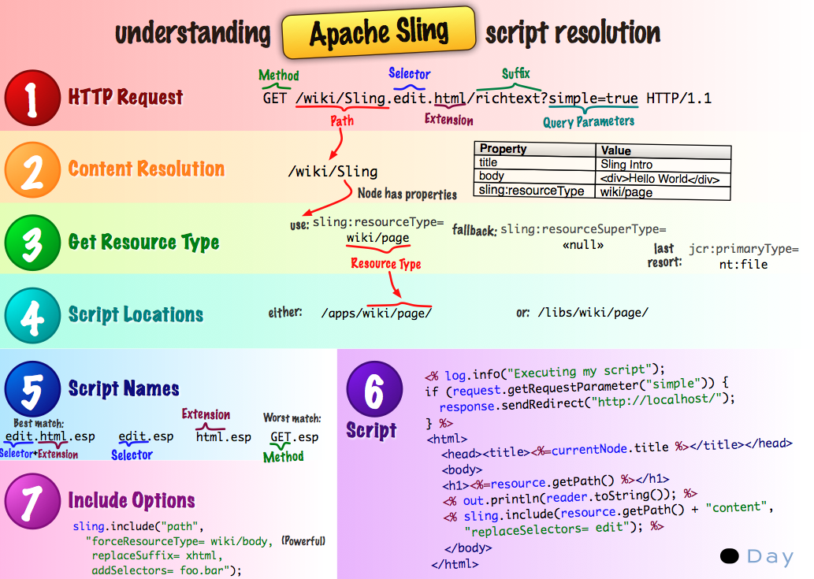
Sling Script Resolution
Notes:
http://sling.apache.org/
Give few examples to explain:
/content/home
/content/home.html
/content/home/print.html
/content/home/print.html/content/about_us
Note that we normally don’t use the suffixes
Talk about :
Reversed execution flow : data first, then the renderer; not presenter that requests the data.
Accessing a specyfied depth -> .2.json
Worth mentioning : sling session can be thought of as data base connection

Slide 11
URL Decomposition Exercise
/content/hello.world.5.json?filter=all

Slide 12
URL Decomposition Exercise
/content/hello.world.5.json?filter=all

Slide 13
Objectives
During this session, you will:
Learn to set up an AEM environment.
Use CRXDE to view and modify content.
Understand how Sling processes a request.
Build a custom AEM Template.
Build simple AEM Components.

Slide 14

Develping Components in CRXDE
Let’s build something!
Notes:
Background: https://pixabay.com/en/building-construction-site-cranes-768815/ CC0 Public Domain

Slide 15

Excercise

Slide 16
What we’re going to build
Application
Component
Content

Slide 17
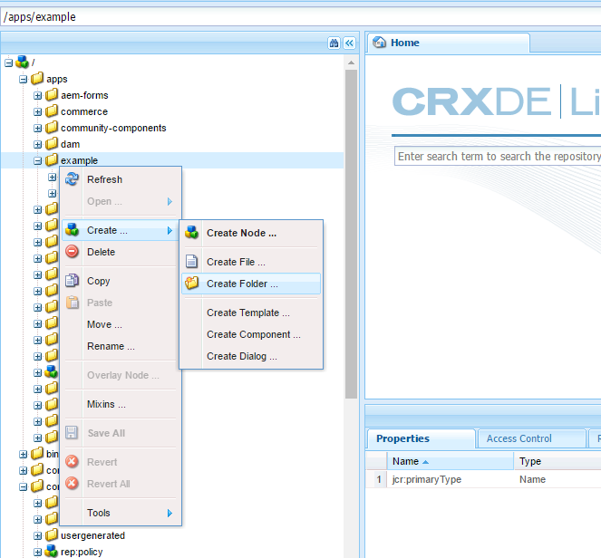
Create a Project in CRXDE
Create a new folder in /apps, let’s call it /apps/example
Create two folders inside it
/apps/exaple/templates
/apps/example/components
Notes:
Create Project button helpfully gone from CRXDE

Slide 18
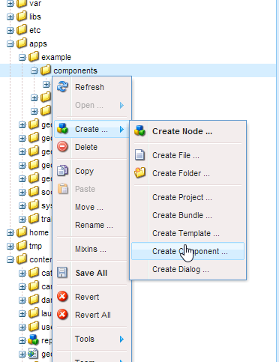
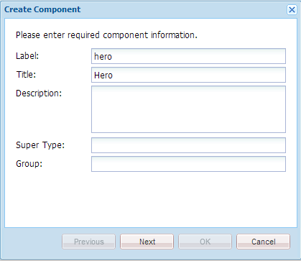
Create a Component in CRXDE

Slide 19
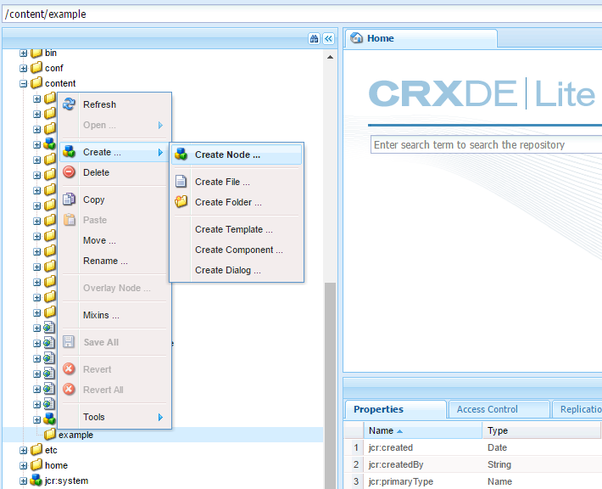
Create Content
Select a path in the repository, somewhere at /content/example
Create a new Node, name it however you like
Set the sling:resourceType property to example/components/hero (the component you created before)
Notes:
Create a node in CRXDE and give it a resource type. Explain what a Resource Type is. Mention that Resource Types can be hierarchical (by defining resource:superType)
https://sling.apache.org/documentation/the-sling-engine/resources.html#what-is-a-resource
Call the node in a browser (don’t go to the page but to the component itself)
Reiterate that Sling looks up the resource. The default servlet selects a script and uses it to render the data.
Create another component and change the resource type.
Be careful about the type of the folder, nt:folder, sling:folder, sling:OrderedFolder
http://stackoverflow.com/a/31430772/1407656

Slide 20
Objectives
During this session, you will:
Learn to set up an AEM environment.
Use CRXDE to view and modify content.
Understand how Sling processes a request.
Build a custom AEM Template.
Build simple AEM Components.

Slide 21

Jumbotron
Part 1

Slide 22
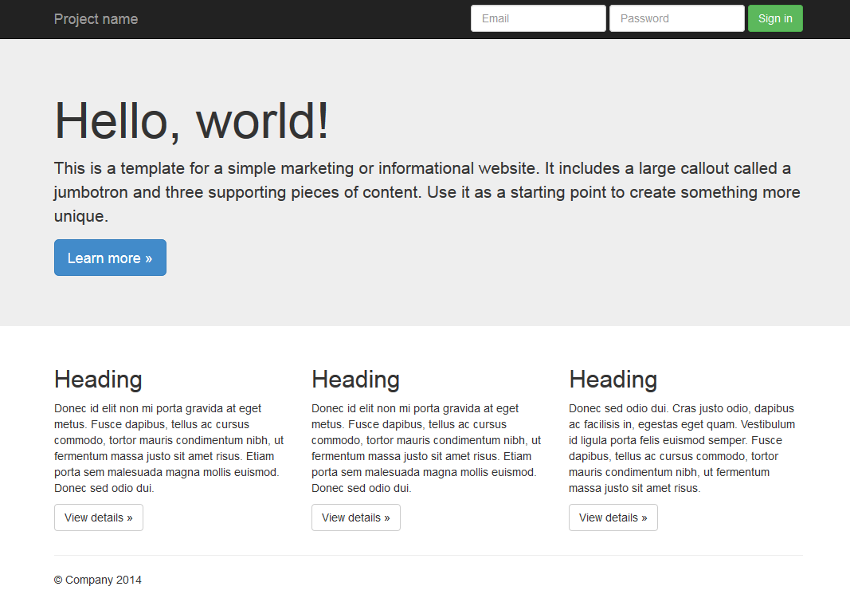
What we’re building
Notes:
The purpose of the excercise is to build a page based on this Bootstrap template: https://getbootstrap.com/examples/jumbotron/
We’ll leave the example project alone and switch to one that’s under version control. We’ll leave CRXDE in favour of an IDE.

Slide 23
What we need to create to achieve it
Template
Renderer
Styles
Edit tools

Slide 24

Start your IDEs
Notes:
We’ll start by checking out the training repository and importing the project into your chosen IDEs.

Slide 25
Build and deploy
mvn clean install crx:install
Notes:
Use this command to quickly build the project and deploy it to AEM.
Mention that the next training module will cover Maven and the project structure in detail.

Slide 26
Building the Jumbotron Page
Create a Template (copy basicTemplate)
Create a Renderer (copy basicRenderer, remove unnecessary files)

Slide 27
Splitting the Renderer
The new Renderer can be divided into three logical parts:
Header
Content
Footer
Use the cq:include JSP tag
It’s good to keep scripts simple and short
Notes:
Explain the difference between including files and resources.

Slide 28
Initialise the sidekick
Add the following code in the <head> element:
<cq:include script="/libs/wcm/core/components/init/init.jsp"/>

Slide 29
Excercise

Slide 30
Jumbotron
Part 2

Slide 31
What we’re building
A component that can be dragged and dropped from the sidekick into a paragraph system and edited.
A component for dynamic navigation.
Notes:
The purpose of the excercise is to build a page based on this Bootstrap template: https://getbootstrap.com/examples/jumbotron/
We’ll leave the example project alone and switch to one that’s under version control. We’ll leave CRXDE in favour of an IDE.

Slide 32
Paragraph System
A script can include a paragraph system component.
<cq:include path="left"
resourceType="foundation/components/parsys" />
Notes:
Explain how once can delegate the processing of a sub-node to a paragraph system component.
Compare and contrast this to including a different component.
Explain how this can be used with cq:template

Slide 33
Using the WCM API
We will use the com.day.cq.wcm.api.Page class to learn about the data to display in navigation:
listChildren()
getPath()
getTitle()
Notes:
Explain how once can delegate the processing of a sub-node to a paragraph system component.
Compare and contrast this to including a different component.
Explain how this can be used with cq:template

Slide 34
Excercise

Slide 35
Objectives
During this session, you will:
Learn to set up an AEM environment.
Use CRXDE to view and modify content.
Understand how Sling processes a request.
Build a custom AEM Template.
Build simple AEM Components.

Slide 36

Thanks for listening!

